Slide 1
Diffie Hellman Key Exchange

Slide 2
Public-key algorithms
Public-key algorithms are based on mathematical functions rather than on substitution and permutation.
More important, public-key cryptography is
asymmetric, involving the use of two separate keys, in contrast to symmetric encryption which uses only one key.
The use of two keys has profound consequences in the areas of confidentiality, key distribution, and authentication
A cryptographic algorithm that uses two related keys, a public key and a private key.
The two keys have the property that deriving the private key from the public key is computationally infeasible.

Slide 3
Principles of public-key cryptosystems
A public-key cryptosystem is based on a pair of keys:
Public key: Shared openly for encryption or verification.
Private key: Kept secret for decryption or signing.
The security relies on hard mathematical problems (like factorization or discrete logarithms).

Slide 4
Two-key Pair (Key Asymmetry)
  Each user has a pair of keys:
    Public key (Kpub​) is known to everyone.
    Private key (Kpriv​) is known only to the owner.
  Keys are mathematically related but it’s computationally infeasible to derive the private key from the public key.
Encryption/Decryption
  Encryption with Public Key:
  Anyone can encrypt a message using the recipient’s public key.
  C=E_{Kpub}(M)
  Decryption with Private Key:
  Only the private key holder can decrypt.
  M=D_{Kpriv}(C)

Slide 5
Diffie–Hellman Key Exchange
Introduced in 1976 by Whitfield Diffie and Martin Hellman.
It’s a cryptographic protocol that allows two parties to establish a shared secret key over a public (insecure) channel.
The shared key can then be used for symmetric encryption.
The magic is that no secret key is sent over the network—yet both parties end up with the same key.
Security relies on the difficulty of solving the discrete logarithm problem.

Slide 6
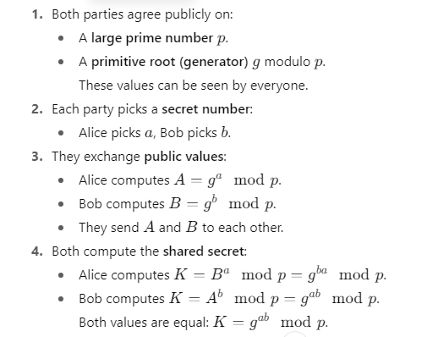
How it Works

Slide 7
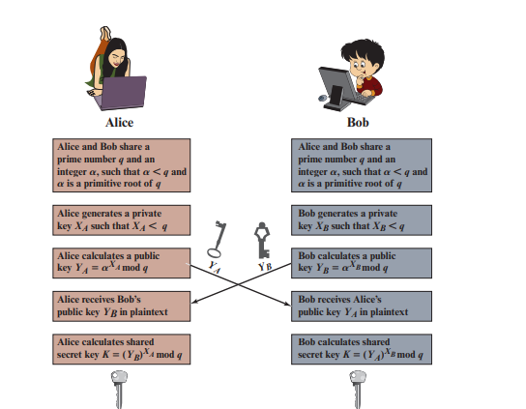


Slide 8
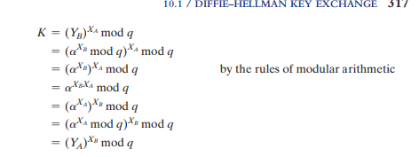

Slide 9
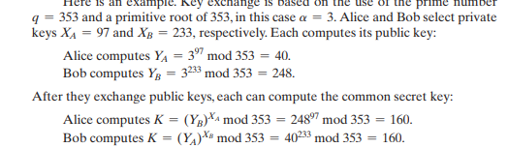

Slide 10
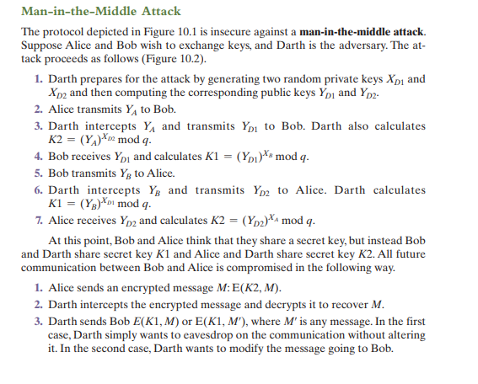

Slide 11
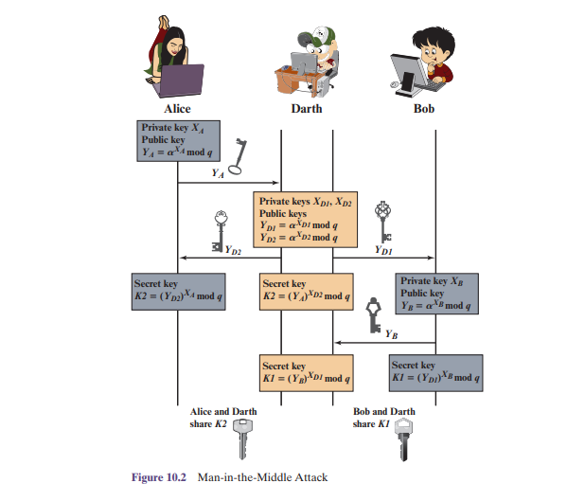

Slide 12
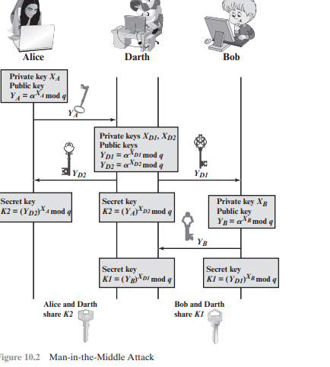

Slide 13
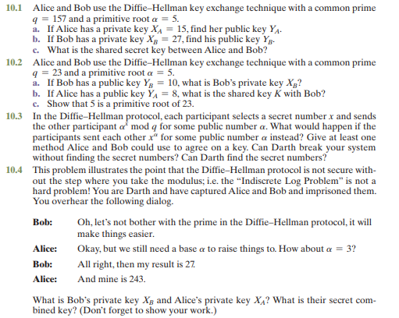

Slide 14
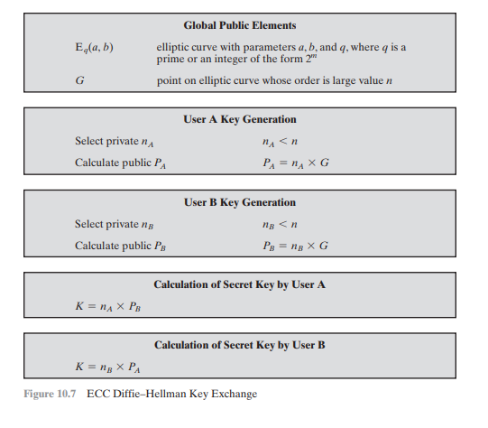

Slide 15
The cryptosystem parameters are E11(1, 6) and G = (2,7). B’s private key is nB = 7.
Find B’s public key PB.
A wishes to encrypt the message Pm = (10, 7) and chooses the random value k = 3. Determine the cipher text Cm.

